Slide 1
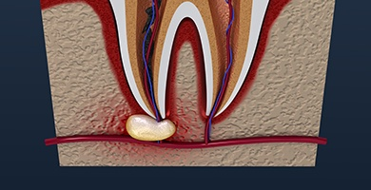
ENDODONTIC SURGERY

Slide 2
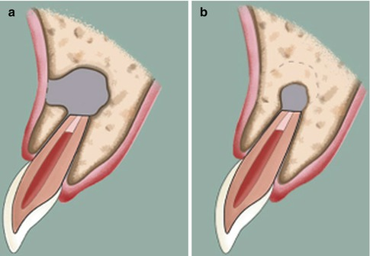
INTRODUCTION
Over the past decade, periradicular surgery has continued to evolve into a precise, biologically based adjunct to non-surgical root canal therapy.
Although non-surgical endodontic treatment gives good results in most cases, surgery may be indicated for teeth with persistent periradicular pathoses that have not responded to non surgical approaches.

Slide 3
DEFINITION
A surgical procedure related to problem of the pulp less or periodontally involved tooth, requiring root amputation & endodontic therapy.
John I Ingle
Removal of tissues other than the contents of root canal space to retain a tooth with pulpal and/or periapical involvement.
Frankil Weine

Slide 4
OBJECTIVES & RATIONALE
Curettage: Effective curettage of the pathologically affected periradicular tissue which cannot be accessed in an ortho grade approach. This includes therapy-resistant granuloma, true cysts, and foreign body reactions.
Resection: Surgical resection of root apex in cases where the apical ramifications cannot be eliminated in a nonsurgical endodontic treatment or surgical resection of a root in cases of poor periodontal support.
Inspection: Inspection of the periradicular area to ascertain causes of failure, inspection of isthmus, and trace accessory canals in nonsurgical endodontic cases that are clinically failing.

Slide 5
INDICATIONS
Failure of nonsurgical endodontic treatment
Failure of nonsurgical endodontic retreatment
Failure of previous surgery
Anatomical problems
Iatrogenic errors
Horizontal apical root fractures
Exploratory surgery & biopsy
Periodontal considerations

Slide 6
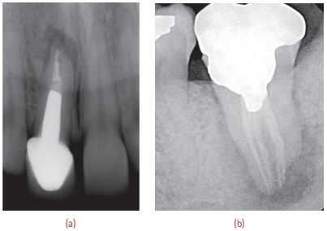
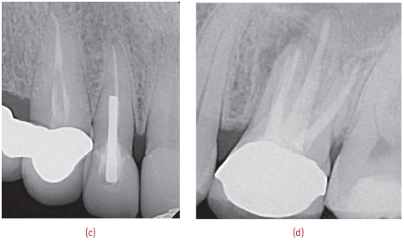
(a) and (b) Persistent periradicular pathology in root canal–treated teeth.
(c) Perforation of the root due to improper post placement. (d) Persistent pain due to overfilling of the canals.

Slide 7
CONTRAINDICATIONS
Inadequate periodontal support and active uncontrollable periodontal disease.
Poor restorability with a post endodontic restoration.
Lesions situated very close to important anatomical structures such as the inferior alveolar nerve, lingual nerve, mental foramen, maxillary sinus when there is high risk of damage to these structures.
Systemic complications of patients such as bleeding disorders, severe heart disease such as a patient recuperating from a myocardial infarction, and immuno compromised patients.
Practitioner’s skill and experience with microsurgical treatment plays an important role.

Slide 8
CLASSIFICATION
According to Gutmann’s
Peri radicular surgery
(a) Curettage
(b) Root-end resection
(c) Root-end preparation and filling
Fistulative surgery
(a) Incision & drainage
(b) Cortical trephination
(c) Decompression procedures
Corrective surgery
(a) Perforation repair
(i) Mechanical (Iatrogenic)
(ii) Resorptive
(b) Periodontal management
(i) Root resection
(ii) Tooth resection
(c) Intentional replantation

Slide 9
Kim’s classification
Class A: Tooth with no periradicular lesion, no mobility, and normal pocket depth. The clinical symptoms have not resolved, though nonsurgical options have been exhausted. Clinical symptoms are the only reason for the surgery. 
Class B: Tooth with a small periradicular lesion with clinical symptoms. Normal periodontal probing depth and no mobility. Teeth in this class-ideal candidates for microsurgery. 
Class C: A tooth that has a large periradicular lesion, progressing coronally; without periodontal pocket & mobility. 

Slide 10
Class D: A tooth that is clinically similar to that in Class C, but has deep periodontal pockets. 
Class E: A tooth that has a large periradicular lesion with an endodontic–periodontal communication to the apex, but no obvious fracture.

Class F: A tooth with an apical lesion& complete denudation of the buccal plate, but no mobility

Slide 11
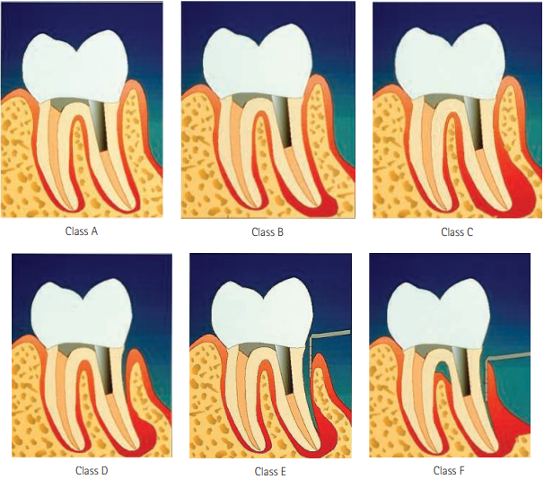
Kim’s classification

Slide 12
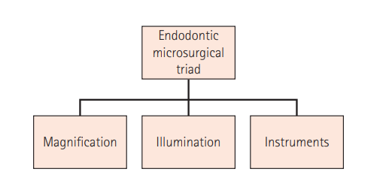
MICROSURGERY
Microsurgery is defined as a surgical procedure on exceptionally small and complex anatomical structures with a dental operating microscope (DOM).

Slide 13
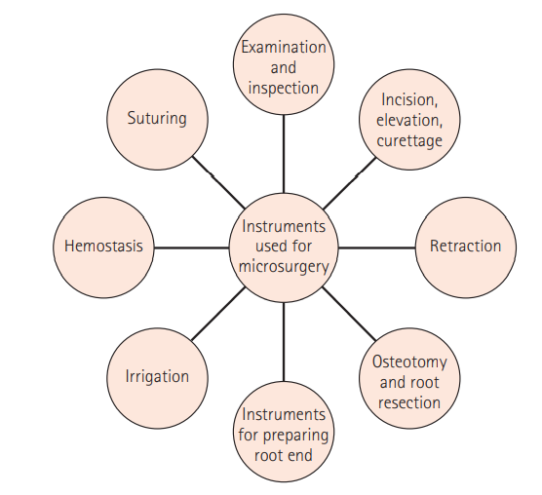
INSTRUMENTS FOR ENDODONTIC MICROSURGERY

Slide 14
Examination and inspection instruments
– Micromirrors
– Periodontal probe
– Endodontic explorer (DG16)
Incision, elevation, and curettage instruments:
- 15c blade and handle (for incision)
Molts curette no. 2–4 (elevation and curettage)
Jacquette curettes and mini-jacquette curettes (to scoop out lesion)
Periosteal soft-tissue elevator or periosteal elevators
Retraction instruments
– KP-1, -2, and -3 retractors
– Carr #1, 45° retractor serrated edge for posterior applications – Carr #2, 90° retractor serrated edge for anterior applications

Slide 15
Osteotomy and apical root resection instruments
– Impact air 45° handpiece
– Lindemann burs
– Micromirrors and microexplorers
Instruments for preparing root end
– Microsurgical ultrasonic instruments
– MTA root-end filling material
Irrigational instruments
– Stropko irrigator
– Microsuction
Hemostasis instruments and materials
Suturing materials
– Sutures
Silk sutures (non absorbable)
Gut sutures (absorbable)
Tevdek sutures
– Tweezers, forceps, scissors, and needle holders
– Needles

Slide 16
(a) Micromirrors. (b) Blades and handle for endodontic microsurgery. (c) Minicurettes. (d) Retractors.

Slide 17
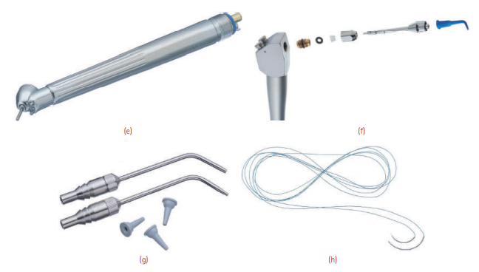
(e) Impact air 45° handpiece. (f) Stropko irrigator. (g) Microsuction. (h) Microsutures

Slide 18
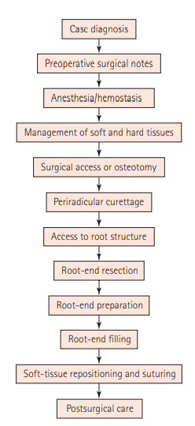
Steps in Endodontic Surgery

Slide 19
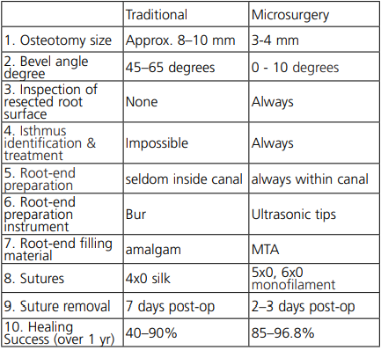
Comparison of traditional vs micro surgery

Slide 20
PRESURGICAL CONSIDERATIONS
Success of surgical treatment vs non-surgical retreatment.
Review of medical history of the patient & consultation with physician if required.
Patient motivation.
Esthetic considerations like scarring.
Evaluation of anatomic factors by taking radiographs at different angles.
Periodontal evaluation.
Presurgical preparation.
Informed consent.

Slide 21
PREMEDICATION
400 or 800 mg ibuprofen per day immediately prior to surgery and mostly advise to continue for 48 hours postoperatively
5 mg valium on the previous night of surgery and on the morning of surgery would take care of patients’ anxiety. 
Generally antibiotic prescription should be avoided; however, when indicated in clinical situations after eliciting a full medical history of the patient, amoxicillin 500 mg t.i.d. for 7 days or clindamycin 300 mg q.i.d. for a week for patients who are allergic to penicillin is recommended.

Slide 22
Mandatory Investigations Prior to Surgery
Bleeding time
Clotting time
Prothrombin time
Thrombin time
Partial thromboplastin time
Activated partial thromboplastin time

Slide 23
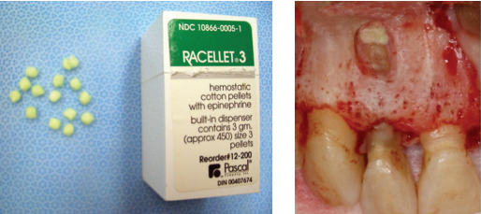
Hemostatic agents

Slide 24
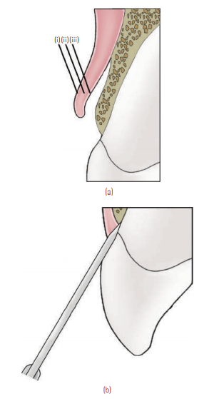
Soft tissue management
Periradicular Surgical Flap Designs
1. Full mucoperiosteal flaps
(a) Triangular (single vertical releasing incision)
(b) Rectangular (double vertical releasing incision)
(c) Trapezoidal (broad-based rectangular)
(d) Horizontal (envelope)
(e) Papilla-based flap
2. Limited mucoperiosteal flaps
(a) Submarginal curved (semilunar)
(b) Submarginal scalloped rectangular (LuebkeOchsenbein)
(a) The mucoperiosteal flap includes the (i) mucosa, (ii) connective tissue, and (iii) periosteum. (b) To elevate the mucoperiosteal flap, the incision must be made to the bone.

Slide 25
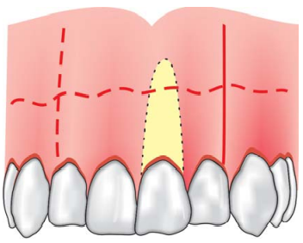
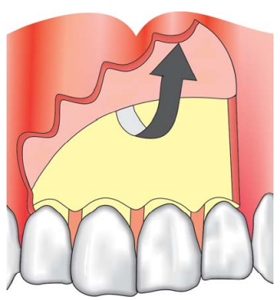
Triangular flap
A horizontal, intrasulcular & a vertical releasing incision.
Advantages
Enhanced rapid wound healing.
Ease of wound closure.
Disadvantage
Limited surgical access.
Indications
• Maxillary incisor region
• Maxillary and mandibular posterior teeth
• It is the only recommended flap design for posterior mandible region.
Triangular flap is not recommended for:
Teeth with long roots (maxillary canine).
Mandibular anteriors because of lingual inclination of these roots.
Reflection of flap

Slide 26
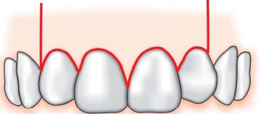
Rectangular flap
An intrasulcular horizontal incision & 2 vertical releasing incisions.
Advantages
Enhanced surgical access.
Easier apical orientation.
Disadvantages
Wound closure as flap re-approximation and postsurgical stabilization are more difficult than triangular flap.
Potential for flap dislodgement is greater.
Indications
Mandibular anteriors
Maxillary canines
Multiple teeth
This flap is not recommended for mandibular posterior teeth.

Slide 27
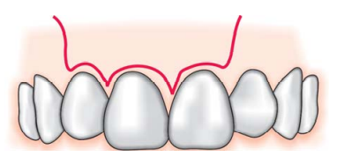
Trapezoidal flap
Trapezoidal flap is formed by two releasing incisions which join a horizontal intrasulcular incision at obtuse angles
Disadvantages
• Wound healing by secondary intention
• Pocketing or clefting of soft tissue
• Compromise in blood supply
• Contraindicated in periradicular surgery

Slide 28
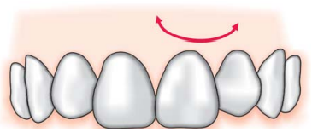
Semilunar flap
First given by Partsch, also known as Partsch incision. It is formed by a single curved incision in the alveolar mucosa & attached gingiva.
No primary advantage and it is not preferred in modern endodontic practice because of its numerous disadvantages.
Disadvantages
Limited surgical access
Difficult wound closure
Poor apical orientation
Potential for postsurgical soft tissue defects by incising through tissues unsupported by bone.
Maximum disruption of blood supply to un-flapped tissues.

Slide 29
Ochsenbein-Luebke Flap
Modification of the rectangular flap
Flap design—in this scalloped horizontal incision is given in the attached gingiva which forms two vertical incisions made on each side of surgical site.
Advantages
Marginal and inter-dental gingiva are not involved
Unaltered soft tissue attachment level
Crestal bone is not exposed
Adequate surgical access
Good wound healing potential—as compared to semi-lunar flap

Slide 30
Indications
In presence of gingivitis or periodontitis associated with fixed prosthesis.
Where bony dehiscence is suspected
Disadvantages
Disruption of blood supply to un-flapped tissues
Flap shrinkage
Difficult flap re-approximation and wound closure
Untoward postsurgical sequelae
Healing with scar formation
Limited apical orientation
Limited or no use in mandibular surgery

Slide 31
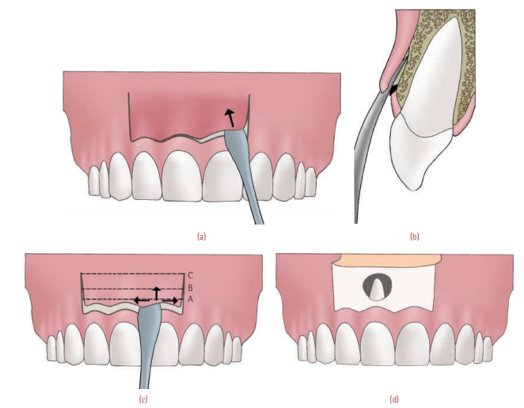
(a) and (b) Raising a Luebke-Ochsenbein flap: The elevator edge, with its concave surface facing the bone, cleaves the periosteum from the bone apically and laterally until the bone above the lesion is exposed. (c) The periosteal elevator should be moved laterally and apically without losing contact with the bone. (d) The extent of the flap should be sufficient enough to expose bone above, below, and around the lesion.

Slide 32
Treatment planning for periradicular surgery
Presurgical patient management
Need for profound LA & hemostasis
Management of soft tissues
Management of hard tissues
Surgical access
Access to root structure
Periradicular curettage
Root end resection
Root end preparation
Root end restoration
Soft tissues repositioning and suturing
Post surgical care

Slide 33
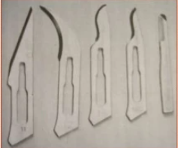
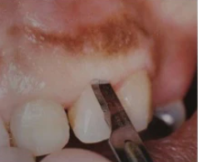
Incision
Incisions for majority of mucoperiosteal flaps for periradicular surgery can be accomplished by: No 11, No 12, No 15, No 15C, microsurgical blade.
The horizontal incision should be made first, followed by the vertical releasing incisions to complete the perimeters of the flap design.

Slide 34
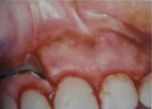
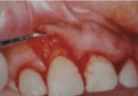
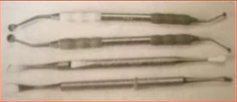
Flap reflection
The process of separating soft tissue (gingiva, mucosa & periosteum) from the surface of alveolar bone.
This process should begin in the vertical incision a few millimeters apical to horizontal and vertical incisions.
Periosteal elevators for flap elevation are:
No 1 & No 2
No 9

Slide 35
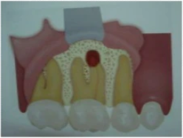
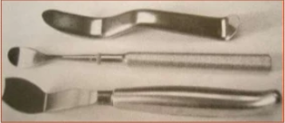
Flap retraction
Process of holding in position the reflected soft tissues.
Provides visual & operative access.
Tissue retractor must always rest on solid cortical bone with firm light pressure.

Slide 36
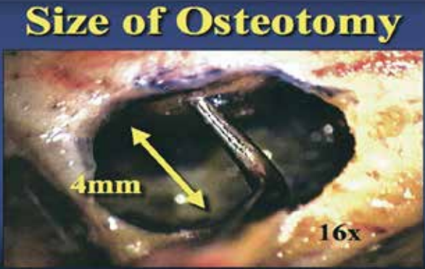
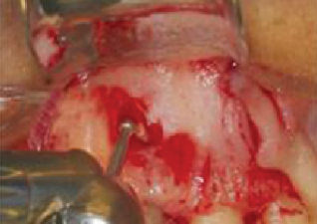
Hard tissue management
(Osteotomy)
Involves the removal of cortical plate to expose the root end in micro endodontic surgical procedure.
Following reflection & retraction of the flap, surgical access must be made through the cortical bone to the roots of the teeth.
Osteotomy size : traditional endodontic surgery – approximately10mm in diameter.
The ideal osteotomy measures 4 mm in diameter allowing a 3 mm ultrasonic tip to move freely within the bone crypt.

Slide 37
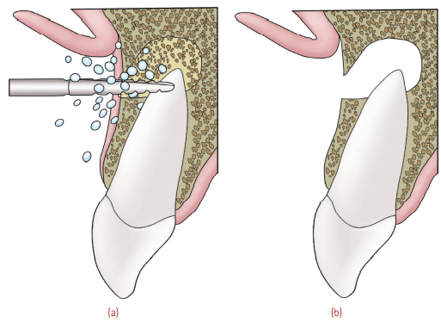
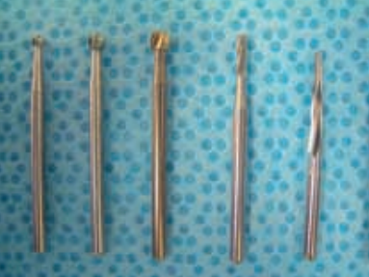
Cutting of osseous tissue with a #6 or #8 round bur produces less inflammation, results in a smoother cut surface, and a shorter healing time than when a fissure bur or diamond bur is used.
Light ‘‘brush strokes’’ with short, multiple periods of osseous cutting will maximize cutting efficiency and minimize the generation of frictional heat.
In areas of restricted visibility, the use of a high speed handpiece with a 45⁰ angled head significantly increases visibility.
(a) The size of the osteotomy should be minimal enough to hasten healing while being large enough to microscopically access, examine, explore, and instrument the root apex. (b) An ideal and adequate osteotomy (4 mm in diameter).
Burs for gaining access to the bony crypt and for resection of the root apex (From left to right: No. 4 round bur; No. 6 round bur; No. 8 round bur; No. 57 fissure bur; multi-purpose bur)

Slide 38
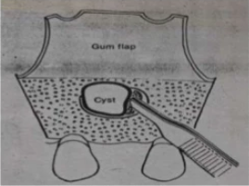
Periapical Curettage
A. Injection of local anesthetic into the periapical lesion. B. Peeling away the lesion with an explorer. C. Removal of periapical lesion with a curette.
A surgical procedure to remove diseased or reactive tissue from alveolar bone in periradicular or lateral region surrounding a pulpless tooth.
Curetted with Molts curette no. 2–4.
Alternatively, Jaquette 34–35 curette can be used to completely remove the granular tissue or cystic pathosis with cystic lining.
The granulation tissue is curetted out from the palatal or lingual aspect of the root tip also.
Hemostasis has to be achieved.

Slide 39
Root end resection
When endodontic surgery is performed in the area around a root apex, root-end resection is almost always a component of the surgical procedure.
Indications
Eliminating
- Anatomical variations
- Ledges
- Canal obstructions
- Resorptive defects
- Perforation defects
- Separated instruments
Visualize the seal created by orthograde treatment & need for root-end seal.
Gain access to pathological tissue trapped along lingual surface of root.

Slide 40
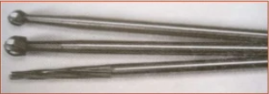
Instruments
Ingle et al recommended the root end resection is best accomplished by No.702 tapered fissure bur or No.6 or No.8 round bur in a slow speed hand piece.
Lasers :
Er:YAG – smooth, clean, resected surfaces free of any thermal damage
CO₂ laser – optimally prepares the resected root end surface to receive a root-end filling.

Slide 41
Rationale for laser use in endodontic periradicular surgery includes:
Improved homeostasis & concurrent visualization of the operative field.
Potential sterilization of the contaminated root apex.
Potential reduction in permeability of root-surface dentin.
Reduction of post - operative pain.
Reduced risk of contamination of the surgical site through elimination of use of aerosol-producing air turbine hand pieces.
Advantages
Absence of discomfort & vibrations
Less chance for contamination of surgical site
Reduced risk of trauma to adjacent tissue

Slide 42
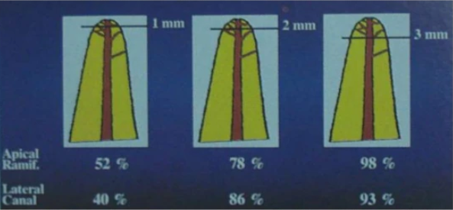
Extent of the root-end resection
The apical 3 mm of the root tip is resected perpendicular to the long axis of the root with the help of a bur in an Impact air 45° handpiece.
The cut root end is examined with medium magnification for the accuracy of cut and any leftover cystic lining, cystic pathosis, or granulation tissue.
This is done to determine whether the entire 3-mm tip is removed or not.
The resection of the apical 3 mm of the root apex will eliminate 98% of the apical ramifications and 93% of the lateral canals which could contain material that would contribute to the periradicular disease.

Slide 43
When a root-end filling is required, enough of the root end must be resected so that the root-end filling material is surrounded by sound dentin.
The amount to be resected may also be dictated by the location of perforation defects, ledges, separated instruments, and the apical extent of posts and orthograde obturating materials.
The level of the crestal bone and the presence of periodontal defects will be major factors in determining how much root end can or should be resected.
The conservation of root length should not compromise the goals of the surgical procedure.

Slide 44
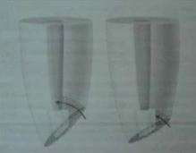
Bevel angle
Historically, 30-45⁰ from the long axis of root facing toward the buccal or facial aspect of the root : to gain visual & operating access to the root tip for resection, placement of retro filling materials, & inspection.
Presently maximum – 10 degree bevel.
Advantages
Exposes fewer dentinal tubules, thus preventing excess leakage & contamination.
Regardless of the angle or the extent of the root-end resection, it is extremely important that the resection is complete and that no segment of root is left unresected.

Slide 45
Root end preparation
Purpose : To create a space into which a root end filling material can be placed.
Objective : Must be placed parallel to the long axis of the root.
Instruments used:
Small round or inverted cone burs
Ultrasonic tips

Slide 46
Ideal root end preparation
Apical 3mm of root canal must be freshly cleaned & shaped.
The preparation must be parallel to & coincident with anatomic outline of the pulp space.
Adequate retention form must be created.
All isthmus tissue when present, must be removed.
Remaining dentin walls must not be weakened.

Slide 47
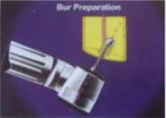
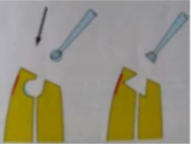
Traditional root end cavity preparation technique:
Miniature contra angle or straight handpiece.
Small round or inverted cone bur is used.
Class I cavity preparation along the long axis of the root within the confines of the root canal.
Recommended depth – 2 to 3 mm (most commonly advocated).
Disadvantage : Apical perforation due to difficulty in aligning the bur.

Slide 48
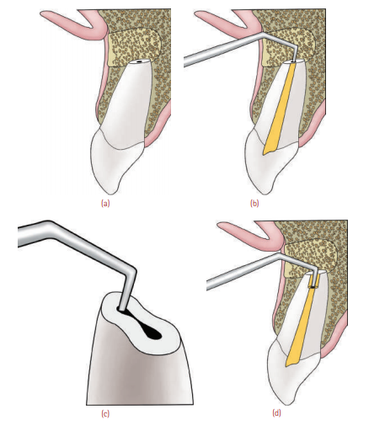
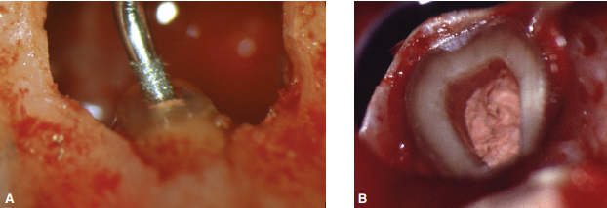
Recently, specially designed ultrasonic root end preparation instruments have been developed.
A. An ultrasonic tip is used to make a root end cavity preparation. B. A Class I root cavity preparation is prepared with the ultrasonic tip to a depth of 3 mm into the canal.
(a) Schematic representation of root-end resection. (b) Ultrasonic retrotip being employed to begin the retropreparation. (c) Isthmus region is best negotiated with an ultrasonic retrotip. (d) 3-mm depth is the depth of an ideal retropreparation.

Slide 49
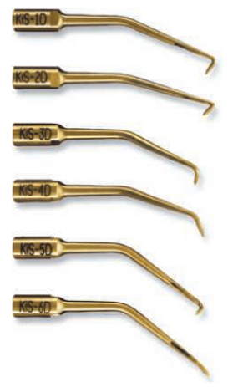
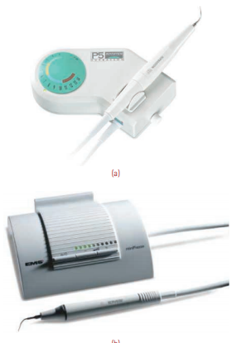
The ultrasonic retrotips have increased cutting efficiency, leaving the dentin surface smooth, yet micros copically rough, which results in better adaptation of filling materials, fewer microfractures, and less leakage.
These retrotips are either stainless steel, diamond-coated, or made of zirconium nitride.

Slide 50
Advantages of ultrasonics in endodontic surgery
Need for beveling is eliminated
Tip stays centered in root & follows canal space
Decreased chances of lingual or root canal wall
Conserving greater thickness of root canal wall
Better access to surgical areas, especially difficult to reach areas such as lingual apices
Deeper root end preparation achieved
Lesser dentinal tubules exposed
Cleaner cavity than bur – smoother, less debris & smear layer
Ultra precise isthmus preparations
Parallel canal walls preparation for better retention of filling materials.
Drawbacks
Creation of micro cracks due to vibrations produced.

Slide 51
Retrograde restorative materials
Purpose :
To seal the apex so that no bacteria or bacterial by products can enter or leave from the canal.
Properties of ideal retrograde restorative material:
Well tolerated by periapical tissues
Bacteriostatic or bactericidal
Adhere to the tooth
Dimensionally stable
Readily available & easy to handle
Not stain teeth / periradicular tissue
Non corrosive & resistant to dissolution
Electrochemically inactive
Promote cementogenesis
Radiopaque

Slide 52
Root-End Filling Materials
MTA
Intermediate restorative material (IRM)
SuperEBA
Glass ionomer cement
Diaket
Composite resins and resin ionomer hybrids
Gutta percha
Amalgam
Cavit

Slide 53
The prognosis ultimately depends upon factors like:
Accurate bevel
Adequate access
Homeostasis
Accurate retrograde preparation
Accurate retrograde restoration
Existent periodontal disease
Occlusal trauma
Missed vertical fractures
Quality of the orthograde filling
Individuals host response.

Slide 54
Closure of surgical area
Repositioning of flap & compression:
The flap has to be meticulously repositioned into the original position from where it was elevated.
One has to also after repositioning the flap compress the tissues so that the flap does not resist suturing.
The repositioned flap should always be kept moist with 2˝ × 2˝ moist gauze until suturing has begun.
Compression results in a thin fibrin clot in the wound site & will result in initial adhesion between the wound edges and intravascular clotting which reduces oozing from the severed microvessels.

Slide 55
Suturing
Purpose : To approximate the incised tissue & stabilize the flapped mucoperiosteum until reattachment occurs.
Classification of suture materials:
Based on material:
Synthetic fibres Natural
Nylon Collagen
Polyester Gut
Polyglactin Silk
Polyglycolic acid
Based on absorbency:
Absorbable Non-absorbable
Polyester Silk
PGA Nylon
Collagen
Gut

Slide 56
Size :
3-0, 4-0, 5-0, 6-0
The higher the first number the smaller the diameter of the suture material.
Structure :
Monofilament & Multifilament
Twisted & Braided

Slide 57
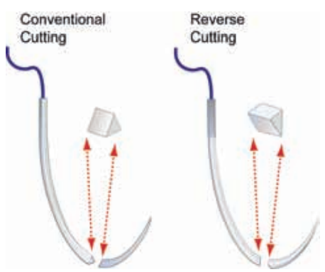
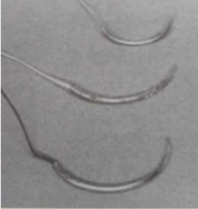
Needles
Surgical needles are designed to carry the suture material through the tissues with minimal trauma.
Needles with reverse cutting edge (the cutting edge is on the outside of the curve) is preferred.
Available in arcs of ¼, 3/8, ½ & 5/8 of a circle, most useful being 3/8 and ½ cirlce.

Slide 58
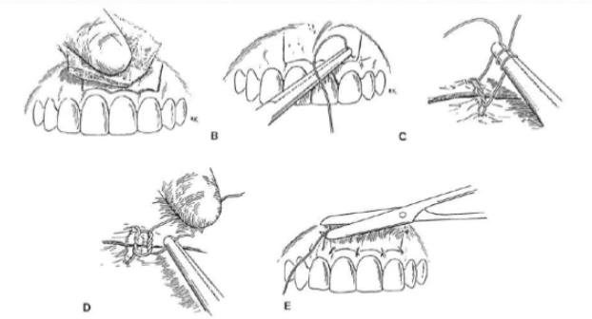
Suturing techniques
Single interrupted
The first bite of the needle should be through the movable tissue. The buccal entry from the incision margin is suitable.
Next, the needle should enter the undersurface of mucoperiosteum of the dependent tissue.
Used for closure and stabilization of vertical releasing incisions.

Slide 59
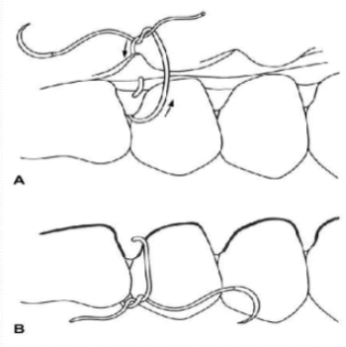
Interrupted loop (interdental) suture:
These sutures are primarily for securing and stabilizing the horizontal component of mucoperiosteal flap.
The surgical needle is inserted through the buccal or facial interdental papillae, then through the lingual interdental papillae, and then back through the interdental embrasure.
It is tied on the buccal or facial surface of the attached gingiva.

Slide 60
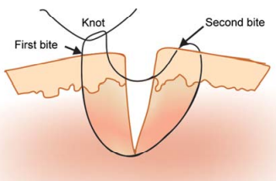
Vertical Mattress Suture
Avoids penetration of tissues in the incisional wound and supports the interdental papilla in a coronal direction.
The surgical needle enters and exits the flapped mucoperiosteum some distance apical from the incision line.
The suture is then passed through the interdental embrasure, directed to the lingual of the adjacent tooth, and passed back through the opposite interdental embrasure.
The needle then enters and exits the flapped mucoperiosteum again, is passed through the embrasure and again, lingual to the tooth and through the opposite interdental embrasure to be tied on the buccal surface.

Slide 61
Horizontal Mattress Suture
Similar concept to the vertical suture except that it extends along a horizontal plane, almost like two simple interrupted sutures lying next to each other.

Slide 62
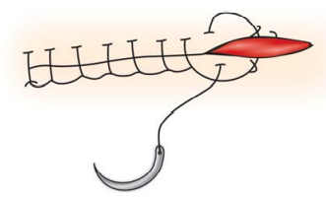
Continuous locking suture
Similar to simple interrupted suture except there are no individual sutures.
It provides watertight closure and is rapid technique for closure.

Slide 63
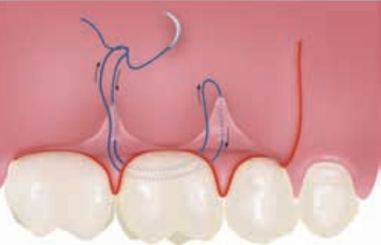
Single sling suture
The surgical needle is passed through the attached gingiva of the flap, through the interdental embrasure but not through the lingual soft tissue.
It is then directed lingual to the tooth and passed through the opposite interdental embrasure and over the incisal or occlusal margin of the flap.
The needle is then passed through the attached gingiva of the flap, from the buccal or facial, back through the embrasure, passed lingual to the tooth, through the opposite embrasure, passed over the flap margin and tied

Slide 64
Postoperative care
The patients should be informed of the complications/ side effects of surgery. The patient is instructed to follow the following protocol:
Use ice packs on first day in cycles of 20 minutes.
Avoid alcohol, smoking and strenuous activity.
Initial diet should consist of liquid supplements including fruit juices & vitamin supplements. Sticky food should be avoided.
Do not tug or lift facial tissues.
Oozing of blood from surgical site during first 24 hrs is normal.
Postsurgical discomfort may remain.
Take analgesics/antibiotics as advised.
Warm saline rinses are advised after 24 hours.

Slide 65
Corrective surgery
It is categorized as surgery involving the correction of defects in the body of the root other than the apex.
Corrective surgical procedures may be necessary as a result of procedural accidents, resorption, root caries, root fracture, periodontal disease.
Involves:
Root resection
Hemi section
Intentional Replantation

Slide 66
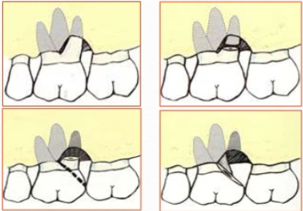
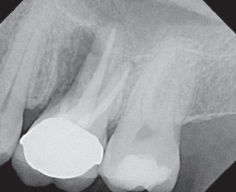
Root Resection
Performed to eliminate weak, diseased root to allow the stronger root(s) to survive when if retained together, they would collectively fail.
Distance between pulp chamber floor & coronal aspect of root separation = 3mm (minimum).
2mm allow for establishment of supra crestal attachment apparatus & 1 mm for placement of crown margins.

Slide 67
Indications:
Existence of periodontal bone loss to the extent that periodontal therapy & patient maintenance do not sufficiently improve condition.
Destruction of a root through resorptive process, caries / mechanical perforation.
Surgically inoperable roots that are calcified, contain separated instruments/grossly curved.
Fracture of 1 root not involve others.
If surgery is technically feasible & prognosis is favourable.
Contraindications:
Lack of necessary osseous support for the remaining root/s.
Fused roots or roots in unfavourable proximity to each other.
Remaining root/s endodontically inoperable.
Lack of patient motivation to properly perform home-care procedures.

Slide 68
Hemisection
Hemisection is defined as separation of a multi rooted tooth and removal of a root & associated portion of the clinical crown.
Indications :
When periodontal involvement of one root is severe.
When loss of bone is extensive in the furcation area.
When caries involves much of one of the roots.

Slide 69
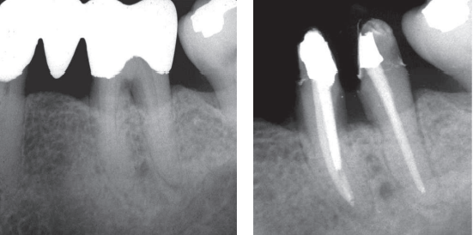
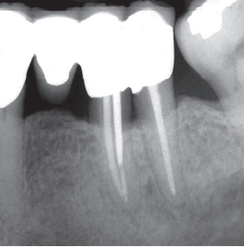
Hemisection of a mandibular molar: (a) Endodontic involvement in a mandibular molar serving as an abutment for a fixed partial denture. (b) Bridge removed, endodontic therapy completed, and hemisection done for improved periodontal health and maintenance. (c) Healing after prosthodontic rehabilitation

Slide 70
Bicuspidization or Bisection
Refers to division of a crown that leaves the 2 halves & the respective roots.
Should be considered in mandibular molars in which periodontal disease has invaded the bifurcation & repair of internal furcation perforation has been unsuccessful.
The furcation is then turned into an interproximal space where the tissue is more manageable by the patient.

Slide 72
Intentional Replantation
Intentional replantation is the purposeful removal of a tooth and its almost immediate replacement, with the objective of obturating the canals apically while the tooth is out of the socket.
Indications
Difficulty of access for surgical endodontics especially in lower second and third molars
When the apex of the involved tooth is in close proximity to key anatomical structures such as the mental nerve
Contraindications
Pre-existing moderate to severe periodontal disease
Curved & flared roots
Non restorable tooth
Missing interseptal bone

Slide 73
3 factors that directly affect the outcome of intentional replantation:
Extra oral time
Keeping PDL cells viable
Minimizing damage to the cementum &PDL cells during elevation & extraction
Technique
Careful extraction of the tooth under adequate asepsis and anesthesia.
Ensure that periodontal ligament is not injured and is frequently washed with HBSS solution during the extra oral procedural time.
The root resection and retrofilling is done with ultrasonic tips and MTA.
The tooth is then reinserted into the socket and the buccal and lingual cortical plates are manually compressed.
A semirigid temporary splint is then placed to stabilize the tooth. Regular follow-up of such cases is important to ascertain the status of such teeth

Slide 74
Beaks of forcep should rest on cement enamel junction so as to avoid injury to periodontal tissue
Any repair or procedure should be done as quickly as possible in the bath of normal saline or HBSS solution to prevent desiccation
Intentional replantation in a mandibular second molar with 6-year follow-up: (a) Preoperative image. (b) Postoperative view. (c) Six-year recall.

Slide 75
Conclusion
Endodontic surgery is dynamic and it is imperative that scientific investigation continue, concepts, techniques and materials used in endodontic surgery must be continually evaluated and modified & more emphasis must be placed on the assessment of long-term outcome.

